Slide 1
CSE7302 - INTERNSHIP Review-3 Presentation TITLE OF THE INTERNSHIP / WORK ASSIGNED / DOMAIN
Student Details
Name | Syed Saifulla H
Roll No | 20231CCS3004
Section | 8CCS02
Under the Supervision of,
Dr./Mr./Ms./Prof.
Professor / Associate Professor / Assistant Professor
Presidency School of CSE
Presidency University
Name of the Program: B.Tech Cyber Security
Name of the HoD: : Dr. Anandraj Sp
Name of the Program Internship Coordinator: Dr. Sharmasth Vali
Name of the School Internship Coordinator: Dr. Md Ziaur Rahman

Slide 2
Content
About Company or Organization
Working domain or the technology
About your team and reporting Manager
Challenges Faced in Internship
Objectives of the work
Literature Review
Proposed System
Problem Statement
System Requirements
Advantages of Proposed System/Work
System Design
System Implementation
Internship Roadmap
Github Link

Slide 3
About Company or Organization
COMPANY: TATA Advanced Systems Limited (TASL)
INDUSTRY: Aerospace, Defense, and Security Solutions
OVERVIEW:
• Strategic unit of Tata Group focusing on high-technology defense solutions
• Critical infrastructure supporting national security projects
• State-of-the-art IT security implementations
• Compliance with stringent defense security standards
IT DEPARTMENT ROLE:
• Provides secure, scalable IT infrastructure
• Manages endpoint security for classified projects
• Implements defense-grade security protocols
• Ensures compliance with regulatory requirements

Slide 4
About Company or Organization
KEY SECURITY AREAS:
1. Network & Endpoint Security
2. Secure Device Management (MDM)
3. Data Protection & Encryption
4. Security Operations Center (SOC)
5. Compliance Management
INTERNSHIP DETAILS:
• Duration: 05-Jan-2026 to 05-Apr-2026
• Location: Bengaluru, Electronics City
• Department: IT - Endpoint Security Unit

Slide 5
Working domain Endpoint Security And Mobile Device Management
TECHNOLOGIES USED:
• Microsoft Intune MDM
• Microsoft Defender for Endpoint
• Graph API for automation
• WinPak Attendance Systems
• Azure Functions & Logic Apps
• PowerShell for automation
• SQL Server for database
KEY RESPONSIBILITIES:
1. Intune MDM Configuration & Management
2. Endpoint Security Testing
3. Device Enrollment
4. Security Compliance Monitoring
5. Automated Security Workflows
6. Incident Response Support

Slide 6
About your team and reporting Manager
TEAM STRUCTURE:
IT Department - Endpoint Management Unit
Security Analysts (3 members)
MDM Administrators (2 members)
Network Security Engineers (2 members)
Intern: Myself (Endpoint Security Testing)
MY ROLE & RESPONSIBILITIES:
✓ Assist in endpoint device security testing
✓ Support Intune MDM deployment and management
✓ Implement automated security policies
✓ Test device enrollment and compliance
✓ Document security configurations
✓ Monitor security alerts and incidents
REPORTING STRUCTURE:
• Reporting Manager: Mr. Satya Prasad
• Designation: Team Lead - Endpoint Management
• Daily Stand-ups: 8:30 AM
• Weekly Review: Every Friday
• Project Updates: Bi-weekly presentations

Slide 7
Challenges Faced in Internship
TECHNICAL CHALLENGES:
1. Complex Enterprise Architecture
• Large-scale infrastructure with multiple integration points
• Legacy systems compatibility issues
• Performance optimization for real-time processing
2. Security Implementation Hurdles
• Balancing security with user productivity
• Certificate management complexities
• Policy conflicts and resolution
3. Integration Difficulties
• API rate limiting and throttling
• Data synchronization delays
• Error handling and recovery mechanisms
PROFESSIONAL CHALLENGES:
1. Corporate Environment Adaptation
• Understanding enterprise workflows
• Compliance with strict security protocols
• Professional communication standards

Slide 8
Objectives of the work
PRIMARY OBJECTIVES:
1. Design and implement automated device security system
2. Integrate attendance tracking with device management
3. Achieve real-time security policy application
4. Ensure minimal user disruption
5. Maintain compliance with security standards
SPECIFIC GOALS:
• Successfully integrate WinPak with Intune MDM
• Achieve <5 minute policy application time
• Maintain 95% system uptime
• Reduce manual security interventions by 40%
• Implement comprehensive monitoring and alerting
EXPECTED OUTCOMES:
1. Enhanced endpoint security posture
2. Automated security workflows
3. Reduced attack surface
4. Improved compliance reporting
5. Scalable security architecture

Slide 9
Literature Review
EXISTING SOLUTIONS:
1. Traditional MDM Systems
• Static policy enforcement
• Manual configuration management
• Limited context-awareness
• High administrative overhead
2. Context-Aware Security Systems
• Location-based policies
• Time-based restrictions
• Network-aware controls
• Limited physical presence integration
RESEARCH GAPS IDENTIFIED:
1. Lack of physical attendance integration
2. Manual intervention requirements
3. Delayed policy application
4. Limited automation capabilities

Slide 10
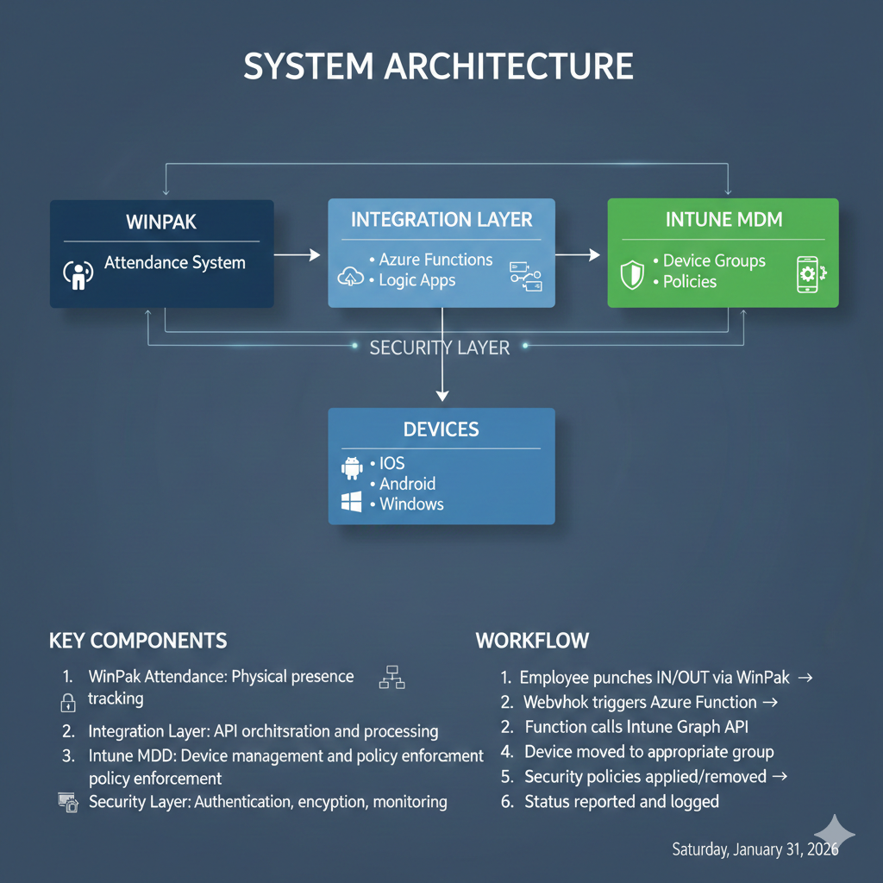
Proposed System / Work

Slide 11
Problem Statement
CURRENT ISSUES:
1. STATIC SECURITY POLICIES
• Same policies applied regardless of location
• No adaptation to user presence
• Security gaps during office hours
2. MANUAL MANAGEMENT
• IT team manually adjusts device settings
• Time-consuming and error-prone
• Delayed response to security needs
3. PRODUCTIVITY VS SECURITY CONFLICT
• Strict security hinders productivity
• Lenient policies create vulnerabilities
• No balanced approach
4. COMPLIANCE CHALLENGES
• Difficulty proving security compliance
• Manual audit trails
• Inconsistent policy application

Slide 12
System Requirements
HARDWARE:
• WinPak Server: Intel Xeon, 32GB RAM, 1TB SSD
• Integration: Azure Standard D4s v3
• Devices: iOS 14+/Android 10+/Windows 10+
SOFTWARE:
• WinPak Enterprise v4.2
• Microsoft Intune
• Azure Functions
• SQL Server 2019
SECURITY:
• OAuth 2.0 + MFA
• TLS 1.2+, AES-256 encryption
• ISO 27001/NIST compliance
• SIEM integration

Slide 13
Advantages of Proposed System/Work
SECURITY:
✓ Real-time policy enforcement
✓ Context-aware adaptation
✓ Reduced attack surface
✓ Automated compliance
OPERATIONAL:
✓ 40% reduced IT workload
✓ <5 minute policy application
✓ Scalable architecture
BUSINESS:
✓ Enhanced security posture
✓ Regulatory compliance
✓ Reduced incident costs

Slide 14
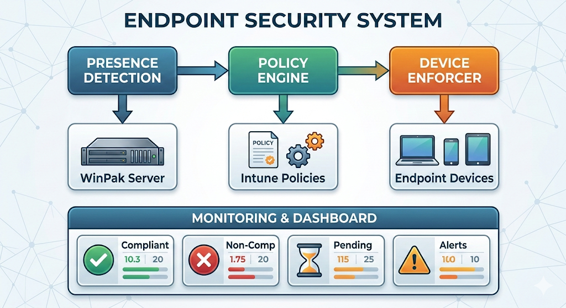
System Design

Slide 15
System Design
Component Diagram
Component | Technology | Purpose
Presence Detection | WinPak Attendance API | Captures employee check-in/out events
Policy Engine | Azure Logic Apps | Evaluates context and applies rules
Device Enforcer | Microsoft Intune Graph API | Pushes configuration to devices
Database | SQL Server 2019 | Stores logs, compliance data
Dashboard | Power BI + Azure Dashboard | Real-time monitoring
Alert System | Microsoft Teams + Email | Notifications for violations

Slide 16
System Implementation (At least 50%)
Component | Status | Completed Features | Pending
WinPak Integration | 100% | API connection, real-time fetching, webhooks | -
Intune MDM | 90% | Auth, policy application, device queries | Bulk ops, error handling
Policy Engine | 90% | Core logic, logging, threading | Device mapping, optimization
Dashboard | 90% | API, real-time, basic UI | Charts, filters
Testing | 90% | Unit tests, integration tests | Load testing, security testing

Slide 17
Internship Road Map
Note: Write in the below table what u will be achieving in each review
Review 1
REVIEW-1 (Weeks 1-4):
Review 2
REVIEW-2 (Weeks 5-8):
Review 3
REVIEW-3 (Weeks 9-12):
Review 4
Final Review
✓ Orientation & requirement analysis
✓ Microsoft Intune tool Learning
✓ Winpak Honeywell Learning
✓ Graph API Testing
✓ Testing setup
✓Complete Device Enrolled
✓Security assessment
✓User testing
✓Final handover

Slide 18

Github Link
The Github link provided should have public access permission.
Github Link
https://github.com/saif8888888888888/TATA Advanced Systems Limited

Slide 19
Q&A

Slide 20
Thank you !!

